Slide 1
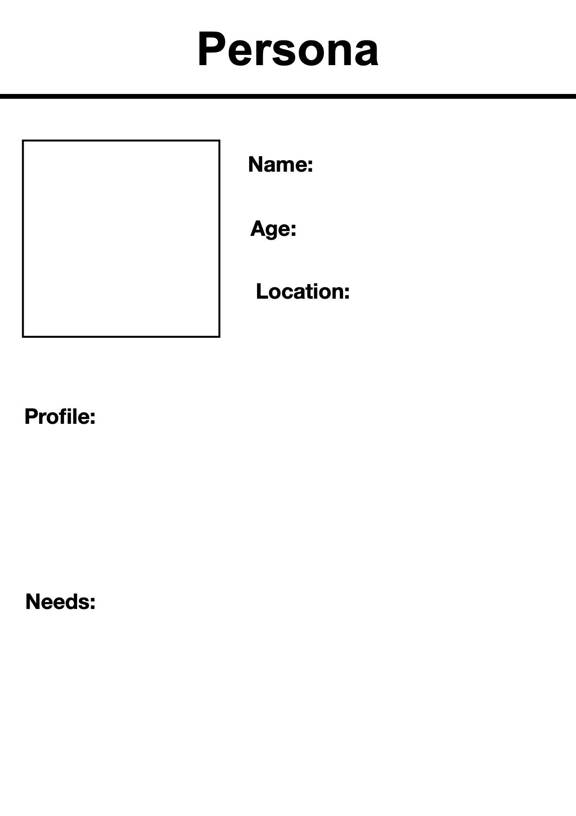
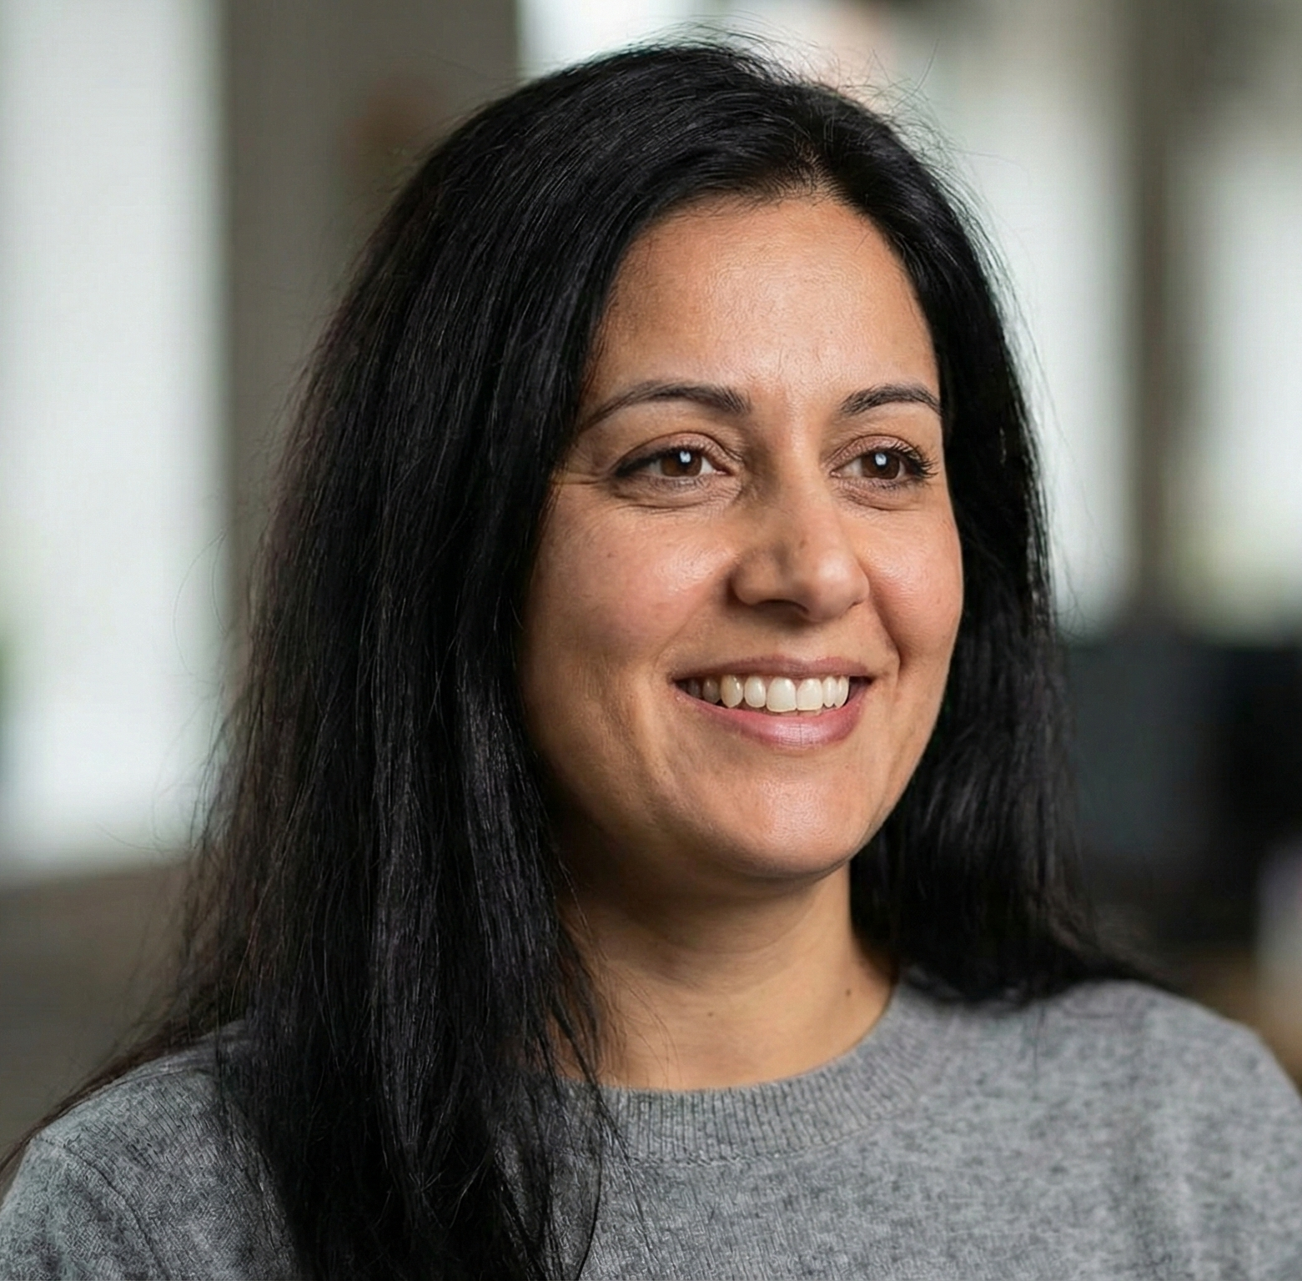
Jia Sharma
28
House in Downtown
Oshawa
Jia is a creative professional working as a Data Scientist for a digital agency in the metro area. She graduated with a degree in Data Science and quickly established herself as a key player in user experience strategy. Jia finds great satisfaction in her creative work, earns a steady income, and benefits from a supportive network that fosters continuous learning.
Jia is looking for ways to keep improving her AI skills, like advanced courses, networking, and leadership programs. She wants housing close to her workplace and support for ongoing learning, so she can stay ahead as AI evolves.

Slide 2
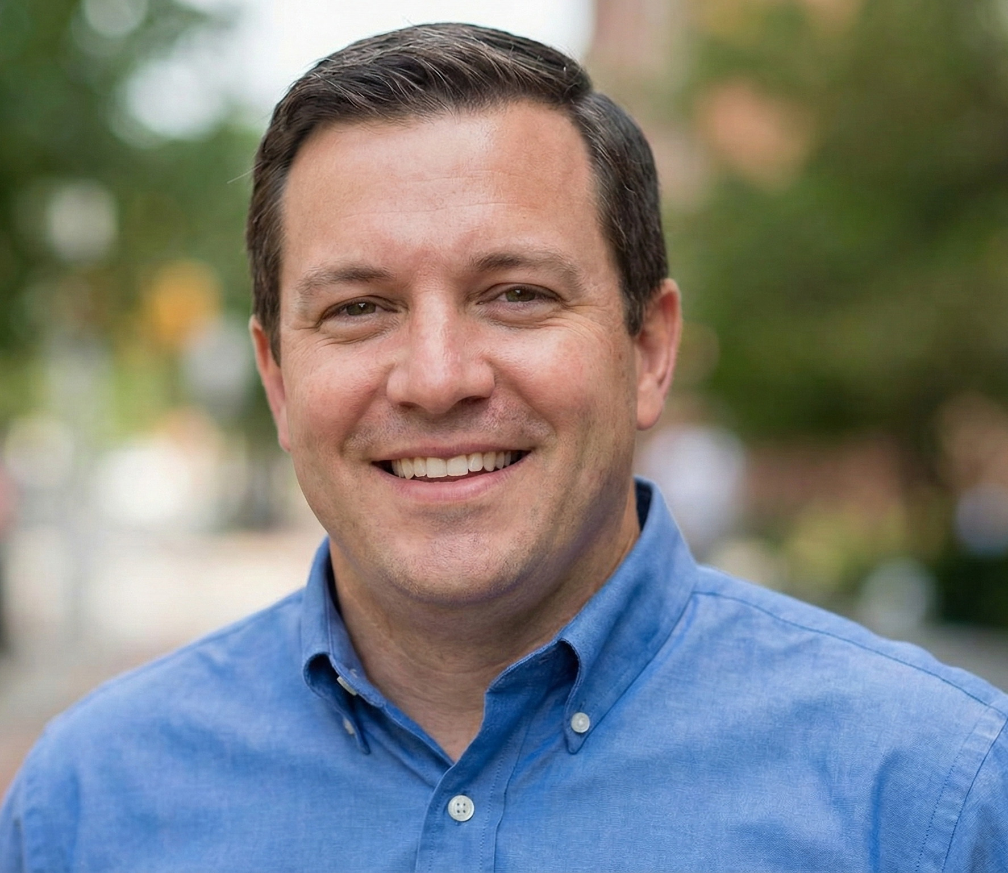
Chris Anderson
26
Basement suite, Oshawa, Durham Region
Chris is a dedicated professional working as a Senior Project Manager for a software firm in the downtown core. He earned his MBA and efficiently oversees complex timelines for high-priority clients. Chris feels valued in his organization, enjoys a competitive salary, and sees clear pathways for advancement within the thriving local tech industry.
Chris wants affordable upskilling options in AI, like basic certificates or introductory classes. He’s looking for guidance to switch careers and for financial help, so he can retrain while working and keep up with living costs.

